Slide 1
Before you get bored of this Presentation -- some cool links
OpenPlans ( http://openplans.org )
Colin’s summer non-profit
Non-profit, OpenSource innovation-shop
The Civic Hacker (awesome blog)
Egov
http://everyblock.com powered by http://openblockproject.org/
http://wiki.openmuni.org/ - Wiki on best open data practices for cities
http://ushahidi.com – Open Source geographic centered crisis information system
Open Transportation
http://OpenTripPlanner.com
Demo: http://maps5.trimet.org/otp
Case of Open Data in Transportation: http://openplans.org/civichacker/2010/08/02/a-case-for-open-data-in-transit/
Education
NYC DoE School of One Pilot http://schools.nyc.gov/community/innovation/SchoolofOne/default.htm
Data Standards
http://open311.org data format for real-world issue reporting (grafitti, fire hydrants, etc). Used by SF and DC
Schools Interoperability Framework (SIF) http://www.sifinfo.org/us/index.asp
Open Zone Integration Server http://www.openzis.org/
Common Cartridge http://www.imsglobal.org/cc/index.html
Cool Applications of Data
http://www.bigappleed.com/
http://slicestation.com/
http://govtracks.us
http://maplight.org
http://cabsense.com
http://exitstrategynyc.com

Slide 2
The State of Open Data in Education
Andy Pethan and Colin Zwiebel

Slide 3
About Us / Disclaimer
Students
Programmers
Education People
FOSS People
Cool Software:
Pauker
Aardvark
We’re not the experts in the room!
But we hope we can help you think differently
Notes:
Students
Olin College of Engineering
Programmers
Andy: summer @ IBM Lotus – data widgets
Colin: summer @ OpenPlans – open transit design
Education People
Alight Learning
FOSS People
We’re not the experts in the room!
But we hope we can help you think differently

Slide 4
Program Flow
Open data
Overview of Education data standards
Discussion
The path ahead

Slide 5
Does Open Source apply to data?
Different topic, same mindset
Building on each others data
Like code, plethora of ways to license data
Focus on the community
Notes:
* You’re the Open Source Crowd
Buuut, we think you’re talents apply well to data, too
We would like to argue, it is more important to push open data than to push for more open software.
You are good at solving this problem
Build on each others shoulders
Lots of fuzzy edges – licensing
Have experience from OpenSource on how to deal with these issues
Ex: OpenStreetMap
Portland can use

Slide 6
- David Pollack founder Of Lift Framework
“The value of LIFT is the community, not the code base.”
Notes:
* Have specific rules to make the community

Slide 7
Notes:
Data begets amazing, innovative software

Slide 8
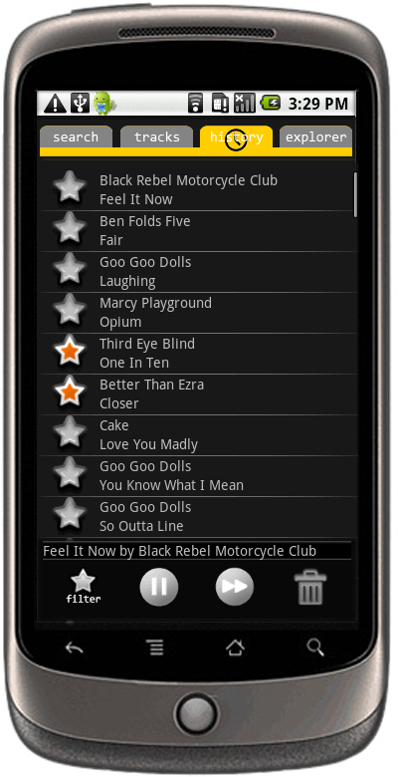
Notes:
* Raw boring data turned into cool shit

Slide 9
The World is Increasingly Data Driven
Number of analytics companies!!!
Smarter Planet initiative
Open Government Initiative

Slide 10
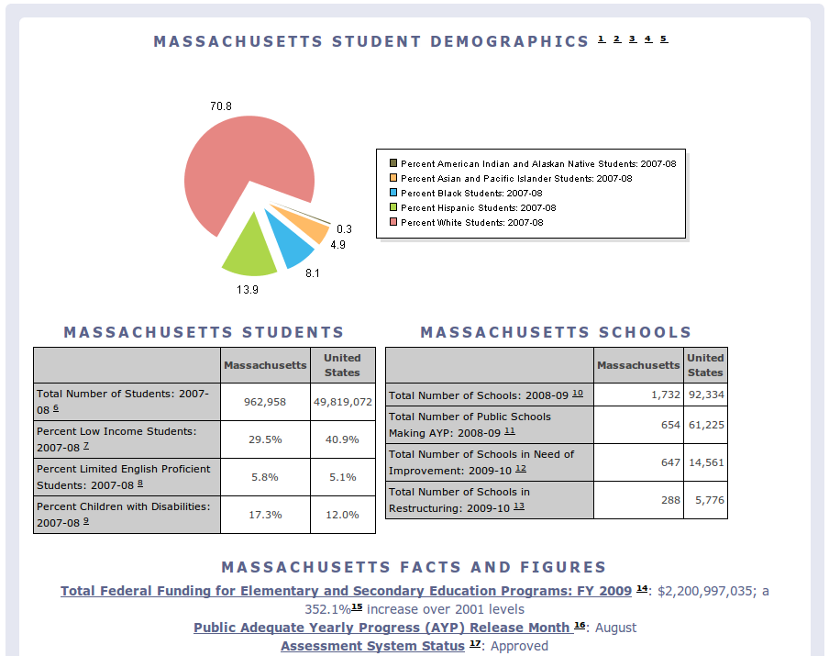
We Need Open Data in Education
What do we want?
Raw
Real-time
What do we have?
Aggregate school reporting
State and national statistics
Inaccessible (PDFs, CDs at specific schools)
We care more that data is available than who/how its stored
Notes:
* More data the merrier
* Either case, we don’t care
* Use ShareAlike where it makes sense
* Use GPL other places were it makes sense
Reporting data is public domain
We care more that data is available than who/how its stored
OSS backend? Proprietary Pearson backend? Fine.

Slide 11
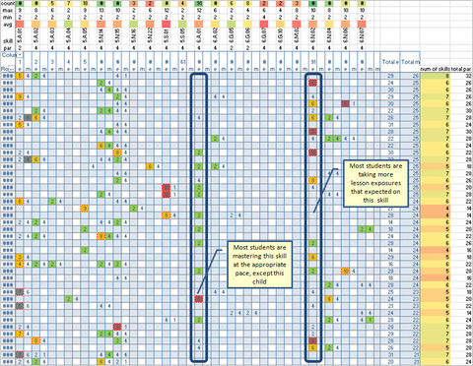
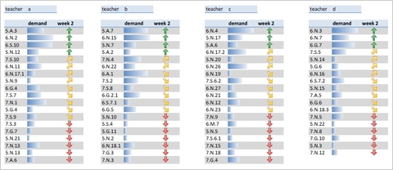
Why?
We think…
Better studies
More informed decisions
Data is proof
But we don’t really know! Imagine…
Twitter and attendance
School of One
Notes:
* Imagine Twitter mashed up with attendance data
* There are good uses out there

Slide 12
Data Lock-in
Vendor specific data sucks
If you don’t work with commercial software, they lock you out
They have enough data to get away with this today – no other collection of data competes

Slide 13
Building a foundation
Every school has a large set of common needs
Facilitation of learning
Schools as a business
Public government
http://openplans.org/civichacker/2010/08/02/a-case-for-open-data-in-transit/
Notes:
There are 4 of them!

Slide 14
Open311, OpenMuni Case Studies
San Francisco, Washington D.C., and Phil Ashlock
OpenMuni
Cities have mishmash of systems, a standard needs to sit on top as abstraction layer
Open source community practices were critical in guiding these standards building initiatives
Notes:
Shift gears here and show what this philosophy and mindset has done in different industries

Slide 15
Open Transportation
Brian Farris – One Bus Away
Developers are nimble –lunch-time hackathon
Real-time data: sensitive?
OpenTripPlanner, OpenStreetMaps
Major existing standards
GTFS
SIRI

Slide 16
Open Education Data Today
Little sharing, not real-time
Major existing standards
National Education Data Model (NEDM)
Schools Interoperability Framework (SIF)
Common Cartridge (CC)
Sharable Content Objects Relational Model (SCORM)

Slide 17
(NEDM)
Standardized way to collect data and describe almost everything:
Students
Blood type
Bus Routes
Neighborhood demographics
No reference implementation

Slide 18
Common Cartridge
Notes:
Standard of IMS Global – non-profit for

Slide 19
Common Cartridge
Transfers content from publishers to LMSes
Commercial buy in:
Blackboard
Pearson
McGraw Hill
FOSS support:
Moodle
Sakai
Notes:
Standard of IMS Global – non-profit for

Slide 20
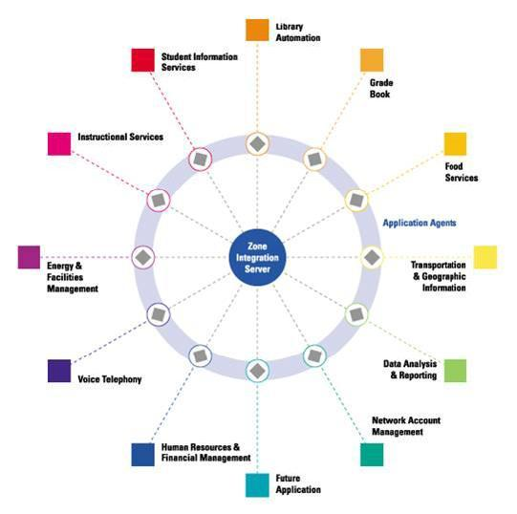
Schools Interoperability Framework

Slide 21
Schools Interoperability Framework
Unifies data from many vendors in a school
Many services communicating via a single traffic director, or “Zone Integration Server”
Open source reference implementation
openZIS
Mature standard, mandated in some states

Slide 22
Take Action

Slide 23
Take Action
In education:
Demand compliance from your school/district
In Development
ACID test of NEDM
NEDM reference implementation
Data-driven educational apps
General
Open Data Repository (Wikipedia for data)

Slide 24
What’s Stopping Us?
Privacy
Consensus building
Budgets
Who’s job?

Slide 25
Open Data and Your Educational Software Project
Ex: educational games
Data producers and crunches need not be the same
Get your data out there!
Data proof

Slide 26
Open Data and Your Data Repository
Support development of data sharing standards
Provide data to the credentialed individuals
Give me easy access to data
Data I’m allowed to see
Let my software do innovative things on a classroom level

Slide 27
We Can Entice people to join the Open data cause thorough Innovation
You are a member of an education project (packaging, marketing, promoting)
Need to get data out there

Slide 28
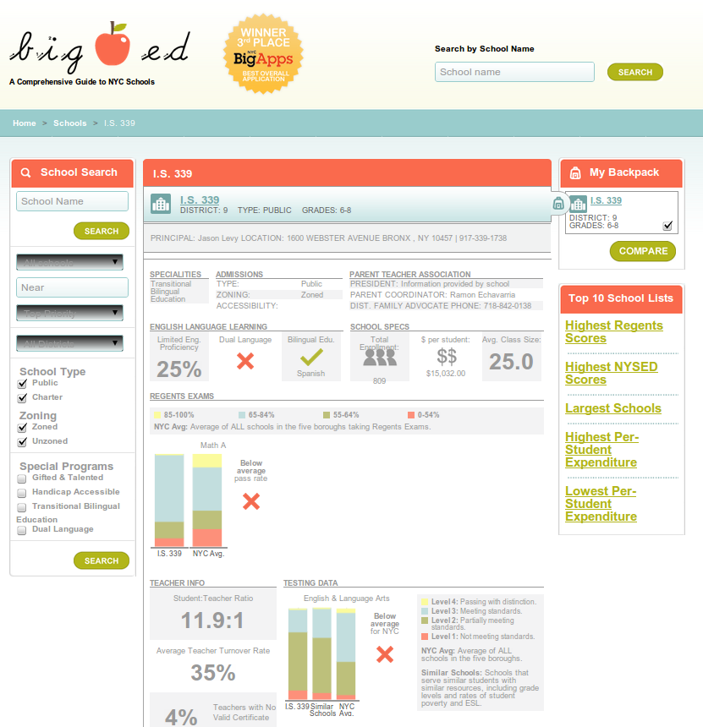

Slide 29
Conclusion
Open data matters for education
Developing standards, educational initiatives, and tech advances look positive
Your skills and mindset are needed in this young movement
And don’t stop innovating!

